Slide 1

Multi-Region High Availability
Making your Apps truly
highly available on AWS

Slide 2



Sponsors

Slide 3
Multi-Region
High Availability

Slide 4

Whats in your SLA?
Notable Outages:
Sept 13 2013
Aug 25 2013
Dec 24 2012
Oct 22 2012
June 29 2012
Notes:
At approximately 8:44PM PDT, there was a cable fault in the high voltage Utility power distribution system. Two Utility substations that feed the impacted Availability Zone went offline, causing the entire Availability Zone to fail over to generator power. All EC2 instances and EBS volumes successfully transferred to back-up generator power. At 8:53PM PDT, one of the generators overheated and powered off because of a defective cooling fan. At this point, the EC2 instances and EBS volumes supported by this generator failed over to their secondary back-up power (which is provided by a completely separate power distribution circuit complete with additional generator capacity). Unfortunately, one of the breakers on this particular back-up power distribution circuit was incorrectly configured to open at too low a power threshold and opened when the load transferred to this circuit. After this circuit breaker opened at 8:57PM PDT, the affected instances and volumes were left without primary, back-up, or secondary back-up power. Those customers with affected instances or volumes that were running in multi-Availability Zone configurations avoided meaningful disruption to their applications; however, those affected who were only running in this Availability Zone, had to wait until the power was restored to be fully functional."

Slide 5
Initial Steps to
High Availability
Auto Scaling
Cloud Watch
Elastic Load Balancers (ELB)

Slide 6
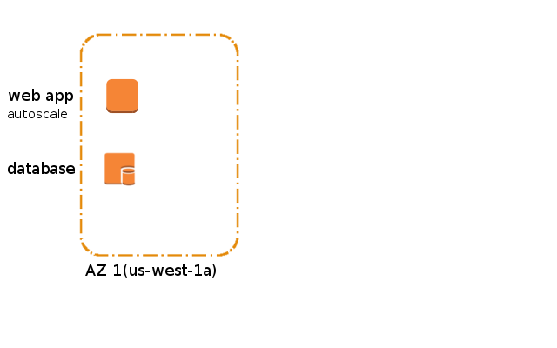
Taking the
Initial Step
A look at a simple web structure

Slide 7
Taking the
Initial Step
Single points of failure at multiple levels

Slide 8
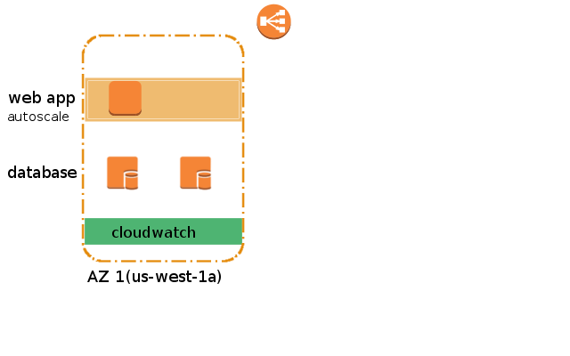
Removing the
Initial SPOF
Add ELB
Add Autoscale
Add DB replication
Add cloudwatch
Notes:
ELB is a Highly Available service with no single point of failure.

Slide 9
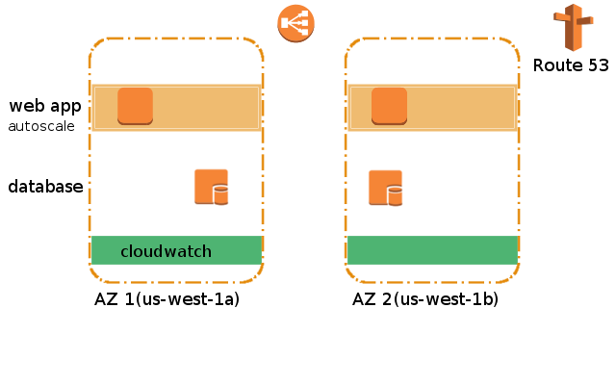
Move to
Multi-AZs
Notes:
Route 53 is a highly availble service with no Single Point of Failure
Route 53 & ELB work hand & hand (more later)
Break your master and Replica into multiple Azs for redundancy
AWS autoscaling can manage EC2 instances across Azs
AWS cloud watch can monitor instances available across AZ's

Slide 10
Configuring ELB to
Use Multi AZs
Elastic Load Balancer (ELB) can be configured to work with multiple Availability Zones (Azs).
If you are using VPC be sure to add the appropriate subnets for each availability zone.

Slide 11

What Happens if the entire Region is Effected?

Slide 12
What Happens if the entire Region is Effected?
Answer:
Move to Multi Region Design

Slide 13
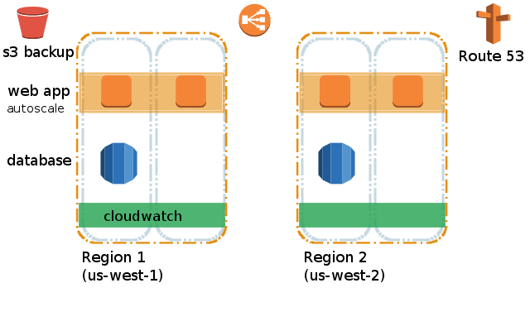
Move to
Multi-Region
Notes:
Route 53 is a highly availble service with no Single Point of Failure
Route 53 & ELB work hand & hand (more later)
Break your master and Replica into multiple Azs for redundancy
AWS autoscaling can manage EC2 instances across Azs
AWS cloud watch can monitor instances available across AZ's

Slide 14
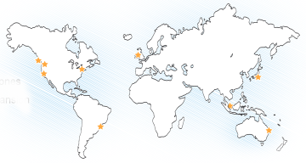
Amazon Global
Infrastructure
10 AWS Regions
US East 1 (Virginia)
US West 1 (California)
US West 2 (Oregon)
EU West 1 (Ireland)
Japan (Tokyo)
South America (Sao Paulo)
ASP 1 (Singapore)
ASP 2 (Sydney)
GovCloud
BJS (Bejing) Limited Preview
25 Availability Zones
51 Edge Locations

Slide 15
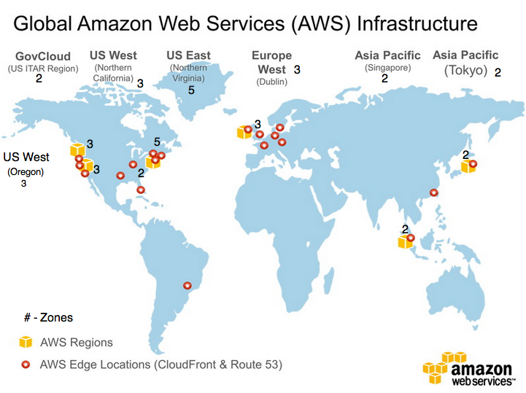
Amazon Global
Infrastructure

Slide 16
Using Edge Locations
What services use Edge Locations?
CloudFront
Route 53

Slide 17
Route 53 &
DNS Failover
In Feb of 2013 AWS introduced a feature of integrating DNS failover for ELB.
Route 53 can detect an outage and redirect your end users to alternate or backup locations you specify.

Slide 18
Route 53 &
DNS Failover
Failover for ELB is available at
NO ADDITIONAL CHARGE

Slide 19
Route 53 &
DNS Failover
When you have more then 1 resource performing the same function, for example 1 HTTP server or mail server – you can configure AWS Route 53 to check the health of your resources and respond to DNS queries using only Healthy Resources.

Slide 20
Route 53 &
DNS Failover
You can set up a variety of configurations using Amazon Route 53 alias
Active-active failover: Use this failover configuration when you want all of your resources to be available the majority of the time. When a resource becomes unavailable, Route 53 can detect that it is unhealthy & stop including it when responding to queries.

Slide 21
Route 53 &
DNS Failover
You can set up a variety of configurations using Amazon Route 53 alias
Active-passive failover: Use this failover when you want a primary group of resources to be available the majority of the time and you want a secondary group of resources to be on standby in case of all the primary resources become unavailable.

Slide 22
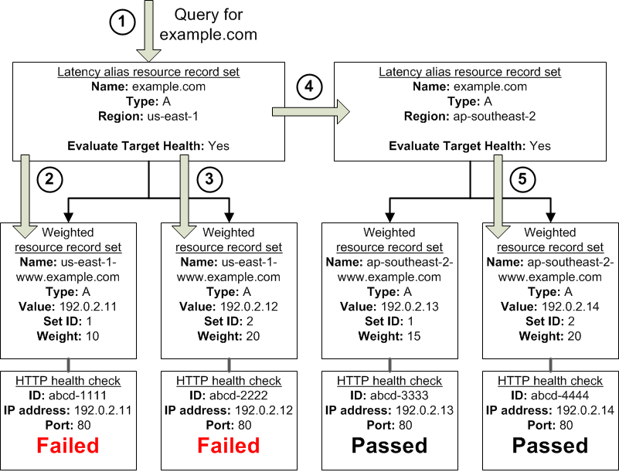
Route 53 &
DNS Failover

Slide 23
Pros & Cons
of Multi Region HA
Pros:
Scalable & Highly Available Architecture
In the event of a failure to one region, the traffic can be diverted to another region in seconds
Allows you to maintain High Uptime for your SLA's
Customers arn't lost due to load or latency problems

Slide 24
Pros & Cons
of Multi Region HA
Cons:
Costs more then regular Multi AZ setup
Technically complex
Requires mid to advanced knowledge of more AWS services
Complete Dependency on Amazon Web Services

Slide 25
HA AWS
Building Blocks
Use the following services when architecting for High Availability
Object & File Storage | AWS S3
Content Delivery | AWS CloudFront
Load Balancing | AWS ELB
Monitoring | AWS CloudWatch
Messaging | AWS SMS

